Slide 1
Define hardware as consisting of physical components of a computer system
Identify internal hardware devices (e.g. processor, motherboards, random access memory (RAM), read-only memory (ROM), video cards, sound cards and internal hard disk drives.
Identify external hardware devices and peripherals (such as monitors, keyboards, mice, keyboards, printers as input and output devices and external storage devices in general)
Define software as programs for controlling the operation of a computer or processing of electronic data
Identify the two types of software – applications software and system software
Define applications software (e.g. word processing, spreadsheet, database management systems, control software, measuring software, applets and apps, photo-editing software, video-editing software, graphics manipulation software)
Define system software (e.g. compilers, linkers, device drivers, operating systems and utilities)

Slide 2







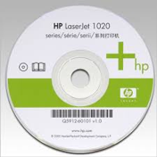



Application
Software
_____________ software are designed to allow users to complete specific tasks.
_____________ software are normally involved in the running of the computer.
System
System Software
Application Software |  | Mobiles Apps
Place image of appropriate software into relevant category.

Slide 3
 |  |  |  |  |  |  |  |  |  |  |  |  |  | 1
 |  |  |  |  |  | 1
 |  |  |  |  |  |  |  |  |  |  |  |  | 2
 |  |  |  |  |  |  |  |  | 2
 | 3
 |  |  | 3 |  |  |  |  |  |  |  |  |  |  |  |  |  |  |  | 4 |  |  | 5
 |  |  |  |  |  |  |  |  |  |  |  | 4
 |  |  |  | 5
6
 |  |  |  |  |  |  |  |  |  | 7
Down
Manage System Operations
Holds data records
Translate a program
Takes sensor readings
Maintain computer security and performance.
Across
Edit and manipulate text documents
Edit images
Allow hardware devices to run
Edit video clips
Combines programming object
Carry our calculations
Activates an output

Slide 4





Application Software
Type | Example Software | Who would use this software: | Use of the software: | Features
Word Processer |  | Students | To complete essays/reports | Format text Insert image, tables & graphs
Spreadsheet
Database
Photo Editing
Video Editing
Measuring and Control
Place image of appropriate software next to each title.

Slide 5

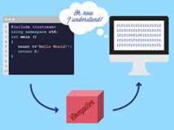
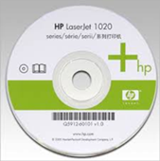
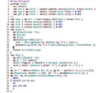

System Software
Match the appropriate image and definition next to each system Software.
Operating System
Manages computers functions including hardware devices (input/output). Also provides users with a GUI interface.
Device Drivers
Combines object files produced by a complier into a
a single program.
Translates a program written in a specific language which can be understood by the computer.
Utilities
Allows hardware devices to run on the computer including printers, sound, graphics and network cards.
Linkers
Help to manage and maintain computer resources and performance by running specific tasks.
Compiler

